Slide 1
Introduction To Neural Network
Name: Chetan Rajaram Salunke
Roll No. : 2144
M.Sc. Statistics
School Of Mathematical Sciences

Slide 2
Content
Introduction
What is Neural Network?
Brief History
Structure of Neuron
Activation Functions
Structure and Model of Neural Network
Forward Propagation
Loss and Cost Function
Back Propagation
Chain Rule
Optimizers
12. Overall Visualization
13. Case Study Using Python

Slide 3
1. Introduction
Neural networks have become increasingly important in recent years due to their ability to learn and adapt to complex patterns in data.
Neural networks can process and analyze large datasets quickly and efficiently, making them well-suited for tasks such as image and speech recognition, natural language processing, and predictive analytics. Also identifying fraud or predicting consumer.
Neural networks can be applied to a wide range of tasks and can be customized for specific applications, making them a versatile tool in machine learning.
Neural networks are driving innovation in fields such as robotics, autonomous vehicles, and healthcare, opening up new possibilities for research and development.
Notes:
In this era of computer and Artificial Intelligence most of the AI tools base on Neural Networks so as Statistician to survive in this competitive world we must familiar with the new and advanced technology which is related to our field. That’s why I chose this topic to curiously learn about it more and introduce it to the most upcoming master Statisticians.

Slide 4
2. What is Neural Network?
Definition:
“A neural network is a method in artificial intelligence that teaches computers to process data in a way that is inspired by the human brain. It is a type of machine learning process, called deep learning, that uses interconnected nodes or neurons in a layered structure that resembles the human brain. It creates an adaptive system that computers use to learn from their mistakes and improve continuously.”

Slide 5
3. Brief History
The concept of neural networks dates back to the 1940s, when Warren McCulloch and Walter Pitts introduced the idea of a computational model inspired by the structure and function of the human brain. They proposed a simple model of a neuron that could be used to simulate logical function.
In the 1950s and 1960s, researchers continued to develop models of neural networks, but progress was slow due to limited computational power and a lack of training algorithms. However, in the 1970s and 1980s, the development of backpropagation and other training algorithms helped to overcome these limitations and led to significant advances in neural network research.

Slide 6
Brief History…
In the 1990s, interest in neural networks declined due to the emergence of other machine learning algorithms, such as support vector machines and decision trees. However, neural networks experienced a resurgence in the 2000s with the development of deep learning, which involves using neural networks with many layers to learn complex representations of data.
Since then, research on artificial neural networks has remained active, leading to many new network types, as well as hybrid algorithms and hardware for neural information processing.

Slide 7
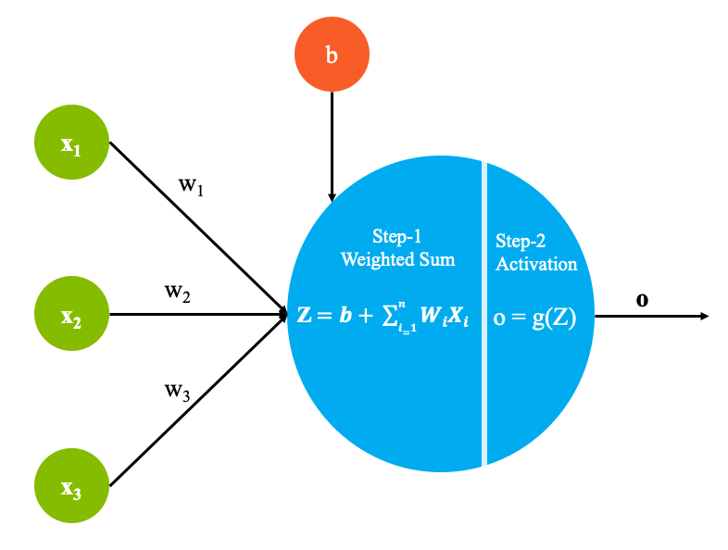
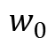
4. Structure of Neuron
Neuron : A neuron is a fundamental building block of a neural network. It is an information processing unit that receives input signals from other neurons or external sources, and produces an output signal based on its internal state and the strength of the input signals.
$$w_{0}$$
(Bias)
Neuron
Notes:
We use Activation Function to Activate Neuron and also Transform linear function to non linear function, to learn more complexity of the data, Normalize the data, its also help while performing backpropagation.(we will see in upcoming slides. Before lets see some of well know activation functions.

Slide 8

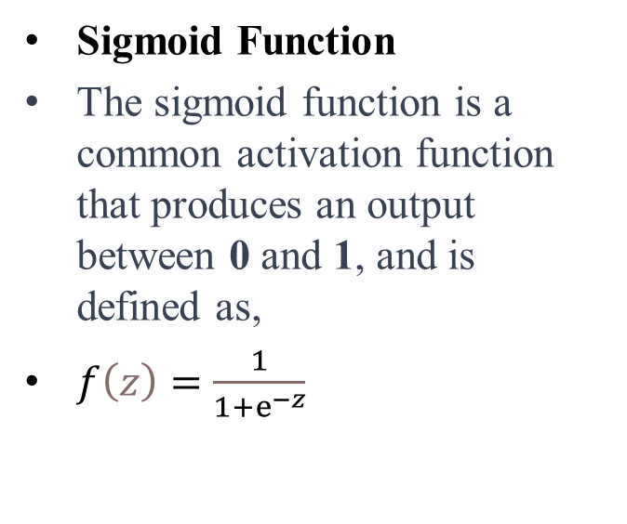
5. Activation Functions
Sigmoid Function
The sigmoid function is a common activation function that produces an output between 0 and 1, and is defined as,
$f\left(z\right)=\frac{1}{1+ⅇ^{−z}}$
This Photo by Unknown Author is licensed under CC BY-SA
Notes:
See the Sigmoid Activation function which we use already in Logistic Regression to Squeaze the output between zero and one.
In case of Classification problem we must use sigmoid function for final output layer.

Slide 9
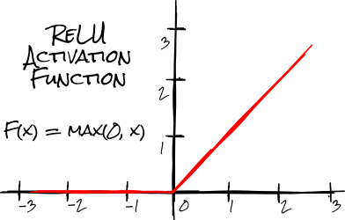
Activation Functions…
ReLU Function
The Rectified Linear Unit (ReLU) function is a popular activation function that produces an output of 0 for any negative input, and is defined as,
f(z) = max(0, z).
Example: f(-2) = max(0, -2)=0.
f(2)=max(0,2)=2
f(z) = max(0, z).
This Photo by Unknown Author is licensed under CC BY-NC
Notes:
ReLU function stands for Rectified Linear Unit
When Relu function get used particular neuron activate if the output of the Relu Function is positive otherwise Neuron not get activated.
In case of Regression problem most of the people try to use Relu Activation function in both input and output layer.
This function outputs 0 for all negative values of z and outputs z for all non-negative values of z. Because the output of the function is not proportional to the input (i.e., it is not a straight line), it is considered non-linear.

Slide 10
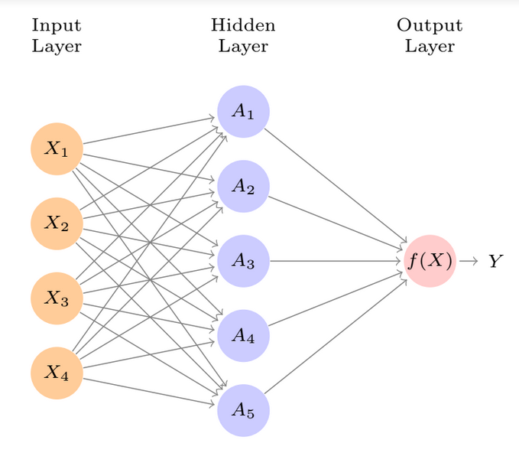
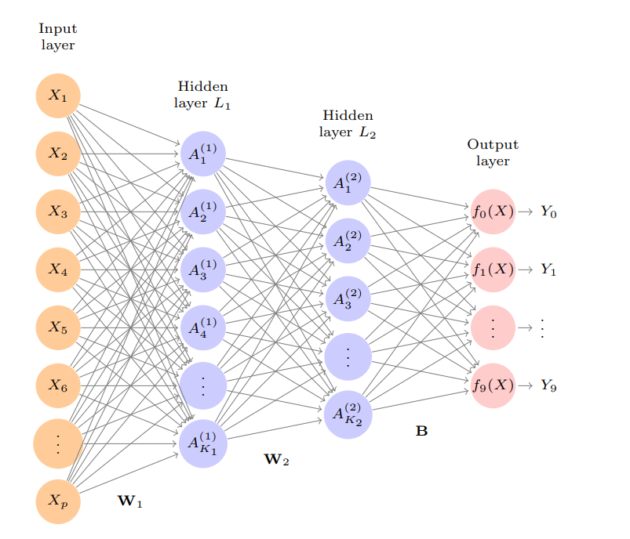
6. Structure of Neural Network
Multiple Layer Neural
Networks
Single Layer Neural Networks
Reference from ISLR
Notes:
The number inside the neuron is call activation.

Slide 11
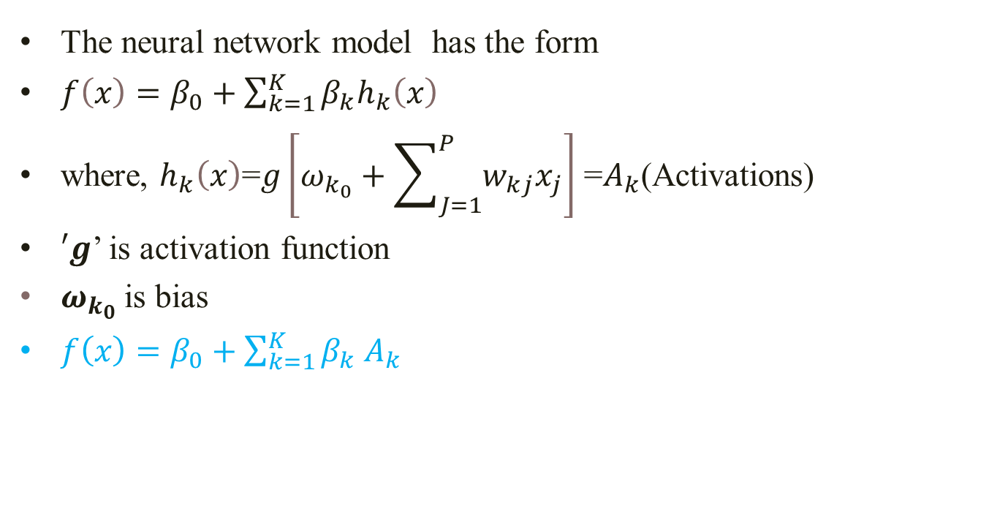
7. Neural Network Model
The neural network model has the form
$f\left(x\right)=β_{0}+\sum_{k=1}^{K}{β_{k}h_{k}\left(x\right)}$
where, $h_{k}\left(x\right)$=$g\left[ω_{k_{0}}+\sum_{J=1}^{P}{w_{kj}x_{j}}\right]$ =$A_{k}$(Activations)
$′g$’ is activation function
$ω_{k_{0}}$is bias
$f\left(x\right)=β_{0}+\sum_{k=1}^{K}{β_{k}}$ $A_{k}$
Notes:
Its look like form of linear Regression model but it not actually because we use activation functions here and we know activation function we used for transform to non linearity.

Slide 12
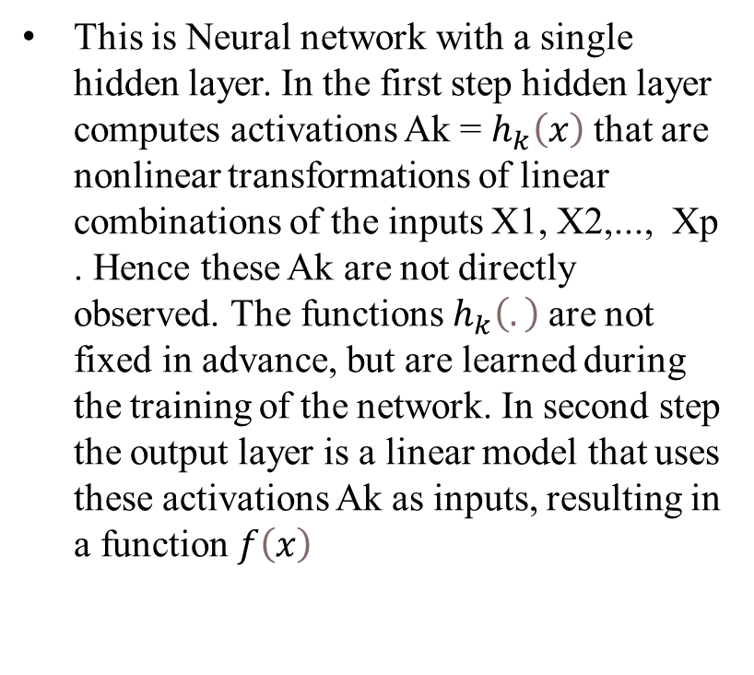
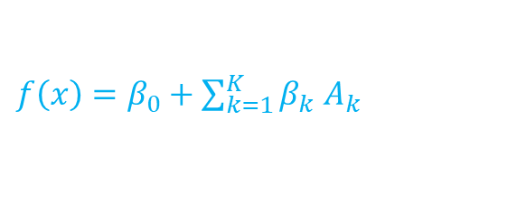
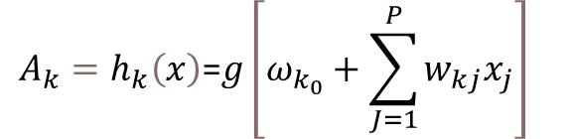
8. Forward Propagation
This is Neural network with a single hidden layer. In the first step hidden layer computes activations Ak = $h_{k}\left(x\right)$that are nonlinear transformations of linear combinations of the inputs X1, X2,..., Xp . Hence these Ak are not directly observed. The functions $h_{k}\left(.\right)$are not fixed in advance, but are learned during the training of the network. In second step the output layer is a linear model that uses these activations Ak as inputs, resulting in a function $f\left(x\right)$
Single Hidden layer
$${A_{k}=h}_{k}\left(x\right)\text{=}g\left[ω_{k_{0}}+\sum_{J=1}^{P}{w_{kj}x_{j}}\right]$$
$f\left(x\right)=β_{0}+\sum_{k=1}^{K}{β_{k}}$ $A_{k}$
Notes:
1)forward propagation which means that the input data is fed in the forward direction through the network.
3) let understand exact how does mathematics and this formula works actually.

Slide 13
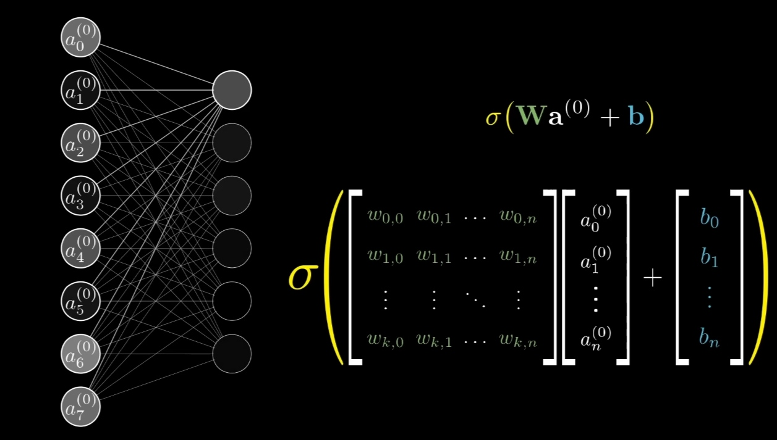
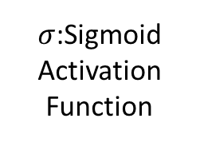
Forward Propagation…
Here,
A=a ,for Activation
$σ$:Sigmoid
Activation Function
Notes:
While understanding the structure of single neuron we saw that to get activation value , algorithm perform in two steps ,In first step, take weighted sum and add bias to it, In second step apply activation function to get activation value of neuron. In Forward propagation we do the same but for all the neurons present in hidden layer until we get output.

Slide 14
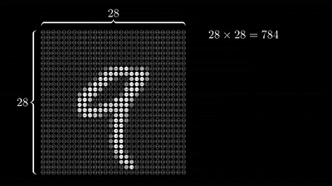
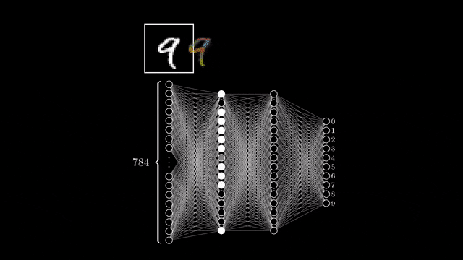
Forward Propagation…
Notes:
Here you can see the process of forward Propagation by visualization. See in the first animation We pass the digit image of dimension 28 cross 28 so we have input of feature 28*28=784. same mathematics work here as we seen in last slides but just difference is , here are two hidden layers so for second hidden layer first hidden layer work as input features and perform same mathematics until we get last ouput. IN second animation you can see we pass the same digit image with input feature 784. In first hidden layer neurons get activate to recognize small part of the digit and in second hidden layer neuron get activate to recognize large part of digit and at last in output layer it recognizing the digit.

Slide 15
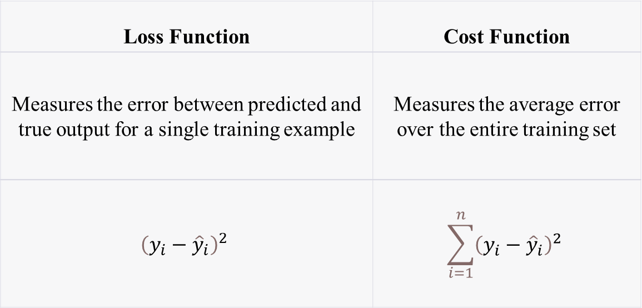
9. Loss and Cost Function
Loss Function | Cost Function
Measures the error between predicted and true output for a single training example | Measures the average error over the entire training set
$${\left(y_{i}−{\hat{y}}_{i}\right)}^{2}$$ | $$\sum_{i=1}^{n}{{\left(y_{i}−{\hat{y}}_{i}\right)}^{2}}$$
L =
L =
Notes:
Goal of every machine Learning model is reduce the error. loss and cost function are error functions.
We use both loss and cost error function interchangeably but both terms are different.
Now purpose is how to minimise the cost function. This cost function get reduce in Back propagation. We will see in next slides

Slide 16
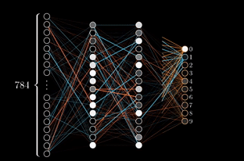
10. Backpropagation
Notes:
The backpropagation is Algorithm where, the error (or loss) of the model's output is calculated and propagated backwards through the layers of the network, with each layer adjusting its weights based on the error of the previous layer. This process is repeated iteratively until the model's predictions are optimized to minimize the error on the training set.
Let see for Single neuron how weights get update

Slide 17
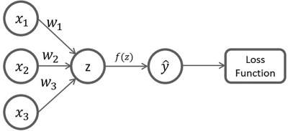
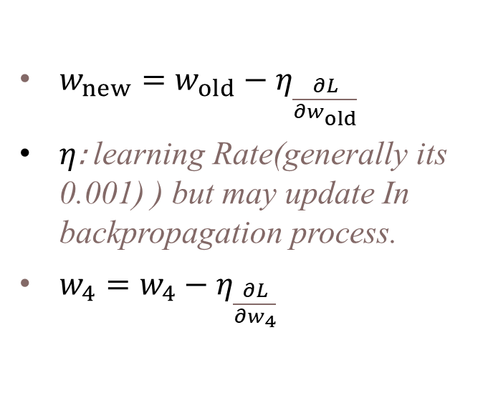
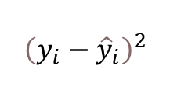

Backpropagation…
$w_{new}=w_{old}−η_{\frac{∂L}{∂w_{old}}}$
$η$: learning Rate(generally its 0.001) ) but may update In backpropagation process.
$w_{4}=w_{4}−η_{\frac{∂L}{∂w_{4}}}$
A1
$$w_{4}$$
$${\left(y_{i}−{\hat{y}}_{i}\right)}^{2}$$
L =
old
new
old
Notes:
Once we get updated values, again forward Propagation will go ahead unless and until the cost function minimize.

Slide 18
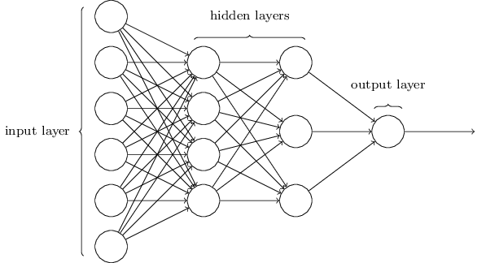
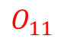
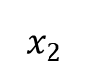
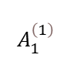
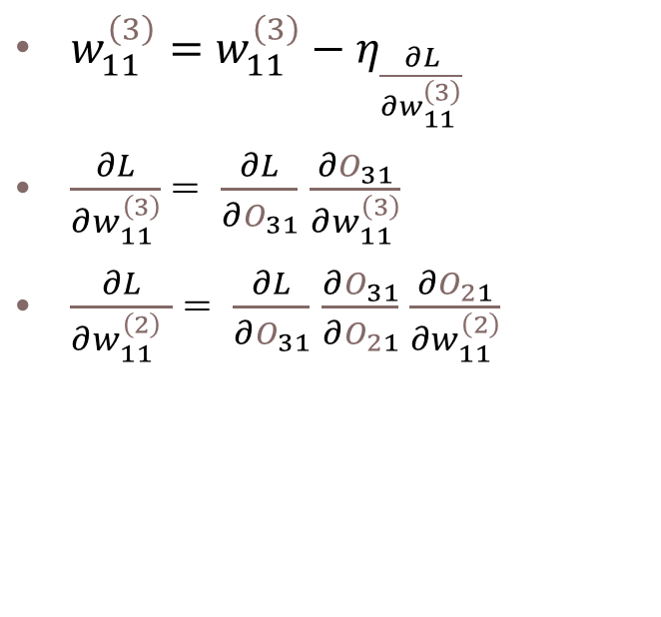
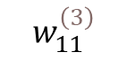
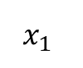
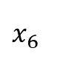
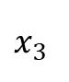
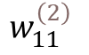
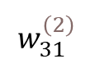
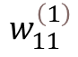
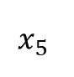
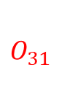
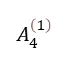
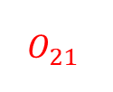
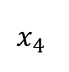
11. Chain Rule
$$x_{1}$$
$$w_{11}^{\left(1\right)}$$
$$O_{11}$$
$w_{11}^{\left(3\right)}=w_{11}^{\left(3\right)}−η_{\frac{∂L}{∂w_{11}^{\left(3\right)}}}$
$\frac{∂L}{∂w_{11}^{\left(3\right)}}$ = $\frac{∂L}{∂O_{31}}$ $\frac{∂O_{31}}{∂w_{11}^{\left(3\right)}}$
$\frac{∂L}{∂w_{11}^{\left(2\right) }}$ = $\frac{∂L}{∂O_{31}}$ $\frac{∂O_{31}}{∂O_{21}}$ $\frac{∂O_{21}}{∂w_{11}^{\left(2\right)}}$
$$O_{21}$$
old
new
old
$$x_{2}$$
$$A_{1}^{\left(1\right)}$$
$$w_{11}^{\left(2\right)}$$
$$w_{11}^{\left(3\right)}$$
$$O_{31}$$
$$x_{3}$$
$$x_{4}$$
$$w_{31}^{\left(2\right)}$$
$$x_{5}$$
$$A_{4}^{\left(1\right)}$$
$$x_{6}$$
Notes:
Let see what chain rule is. This is structure of neural network of two hidden layer. W111,W112,W113 this are Weights corresponding to the first input feature , first neuron of first hidden layer and first neuron of second hidden layer. similarly O11,O21 and O31 this are output of first neuron of first hidden layer and first neuron of second hidden layer and final output layer. Chain rule works for the derivative of the loss function w.r.t. old weights with taking consideration of related outputs to that weight. We know the formula of updating the weights so this is formula we have already seen,

Slide 19
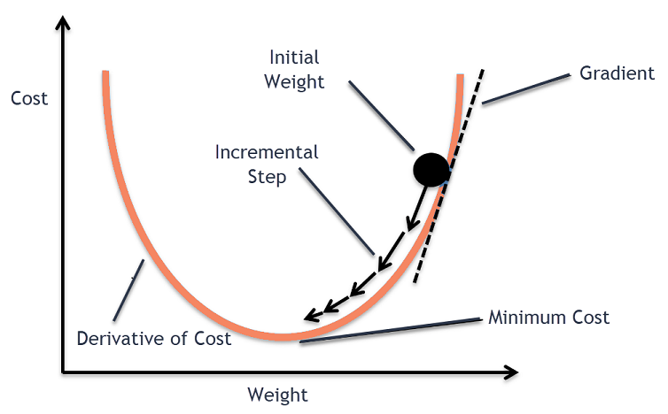
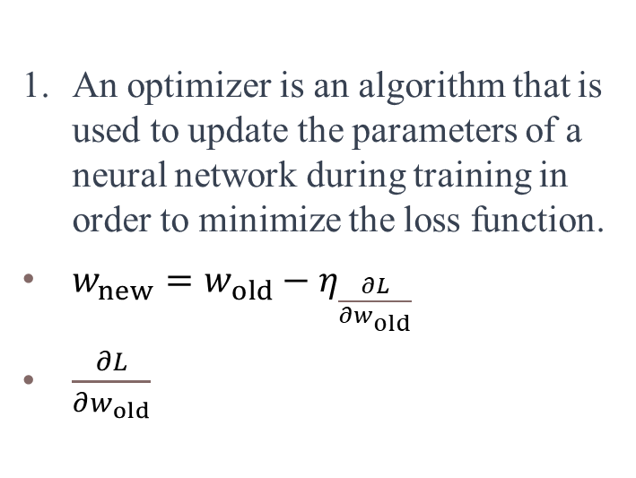
12.Optimizers
An optimizer is an algorithm that is used to update the parameters of a neural network during training in order to minimize the loss function.
$w_{new}=w_{old}−η_{\frac{∂L}{∂w_{old}}}$
$\frac{∂L}{∂w_{old}}$
(Global Minima)

Slide 20
Optimizers..
Gradient Descent: we calculate the gradient using the entire training set and update the weights and biases in the direction of the negative gradient. (For Total n Observation)
Stochastic Gradient Descent (SGD): Stochastic gradient descent is updates the weights and biases after each individual training example is presented to the neural network.
Mini Batch SGD: Mini-batch gradient descent we update the weights and biases after each mini-batch of training examples.
(For k (k<n) Observation)

Slide 21
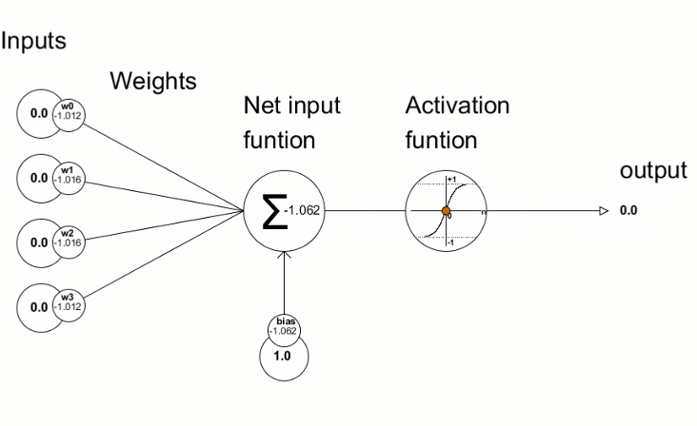
13. Overall Visualization
All procedures for single Neuron
Notes:
Here you can see the all the procedure forward propagation backpropagation, Weights updating procedure for single neuron.

Slide 22
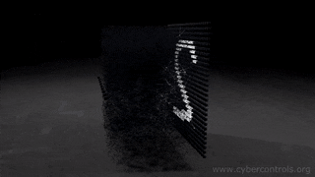
Overall Visualization…
Notes:
Here in the last you can see all the procedure for completer neural network model.

Slide 23
Reference
Introduction To Statistical Learning
https://youtu.be/CqOfi41LfDw (Stat Quest)
https://youtu.be/aircAruvnKk (3Blue 1Brown)
https://youtu.be/YFNKnUhm_-s (Krish Naik)
https://youtu.be/Mubj_fqiAv8 (Code Basic)
https://www.analyticsvidhya.com/ (Analytics Vidya)

Slide 24

This Photo by Unknown Author is licensed under CC BY-NC

Slide 25


